Slide 1
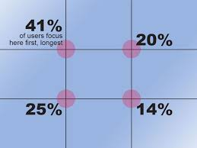
The Rule of Thirds

Slide 2
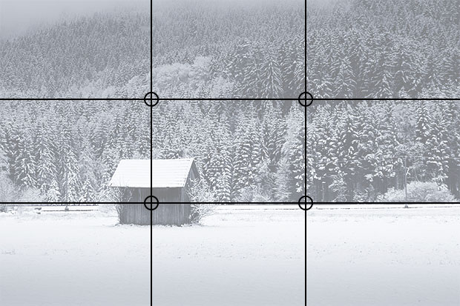
The rule of thirds is an essential photography technique. It can be applied to any subject to improve the composition and balance of your images.
The rule of thirds involves mentally dividing up your image using 2 horizontal lines and 2 vertical lines, as shown below. You then position the important elements in your scene along those lines, or at the points where they meet.

Slide 3
HOW TO USE THE RULE OF THIRDS
When framing a photo, imagine the scene divided up as above. Think about what elements of the photo are most important, and try to position them at or near the lines and intersections of the grid. They don't have to be perfectly lined up as long as they're close.

Slide 4
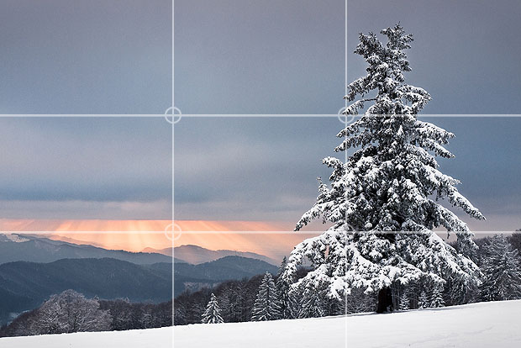
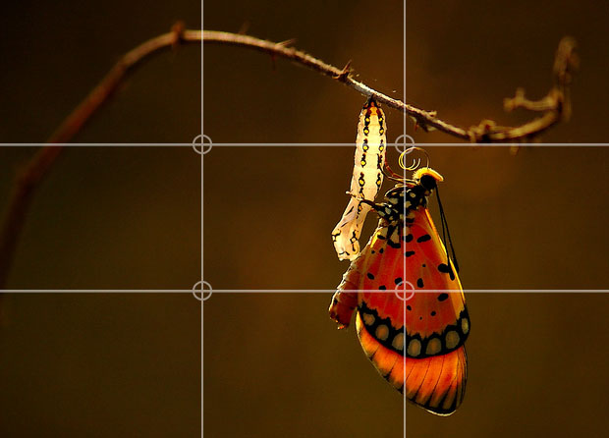
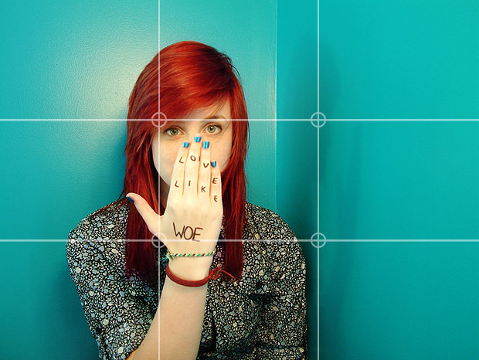
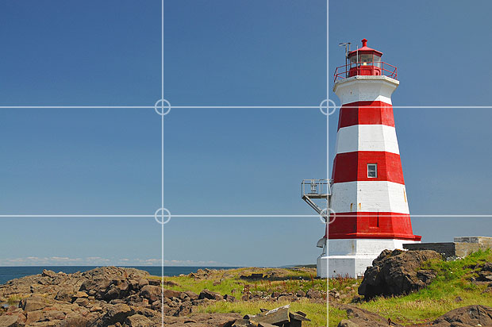
Examples of good use of rule of thirds

Slide 5
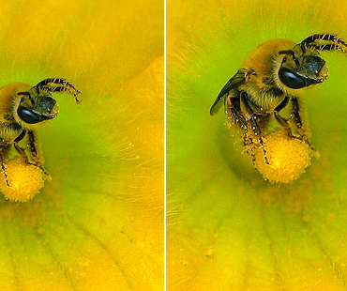
USING EDITING SOFTWARE
You can easily apply the rule of thirds to existing photos by cropping them. This allows you to reposition the important subjects in your image, moving them into more pleasing positions.

Slide 6
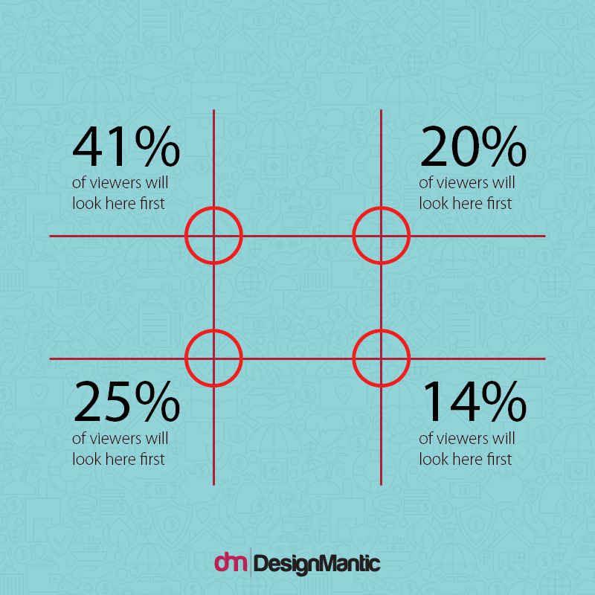
What Is The Benefit Of This Grid For Your Logo Design?
Well, the most significant benefit of the Rule of Thirds is that it tells you how the viewer’s eye is guided within a frame. What does it mean for your logo design? It means you can figure out where to place the elements of emphasis!
The Rule of Thirds tells us the following things about how our eyes travel through a design:
The Overall Path of The Eye: It tells us that the common eye first travels top to bottom and then left to right through a composition. In a Rule of Thirds grid, you will often see the eye traveling from the top left to the bottom left and then from the left to right of the grid.
Center is Not Always The Focal Point: It tells us that the centered location is not always the most viewed location! In fact, according to research, it has been found that people focus most on the top left intersection of the Rule of Thirds grid. This means the center actually goes unnoticed in this case!
Symmetry is Disregarded by the Brain: One of the reasons why the eye focuses on these hot spots is because symmetry is familiar for the brain and is often disregarded by it. This means, an image that is slightly off the symmetry, for example when an image follows the composition along the Rule of Thirds, is more likely to catch the attention of your brain because it is different.
The Importance of Natural Focus: Because these intersections are points of natural focus, it is beneficial to utilize this in your design and to place your key elements on them.
This image shows how the eye focuses on a composition. 41% of the people at once zoom into the top left intersection, then drop down to the bottom left intersection, followed by moving onto the top right and then bottom right.

Slide 7
Other Benefits Of Rule Of Thirds For Your business Logo
While helping you figure out the best focal points is one benefit of the Rule of Thirds, designing your creative logo with the Rule of Thirds will help your design task in many other ways too. Here are some of the benefits of the Rule of Thirds:
1. Helps Create Motion
The Rule of Thirds helps you break away from the symmetry. It allows you to place your elements at 1/3rd of a distance, which creates an interacting space between them. And often, the Rule of Thirds allows you to leave the much needed 2/3rd negative space.
This means, your overall composition gains a sense of motion and flow, and this is imperative to good design. Rule of Thirds can help you create a natural sense of motion. Here is an example of the logo elements can be placed in the frame to create a sense of motion:
Notice how the bridge post is placed on the 1/3rd of the frame, keeping the other 2/3rd free. This creates a sense of motion.

Slide 8
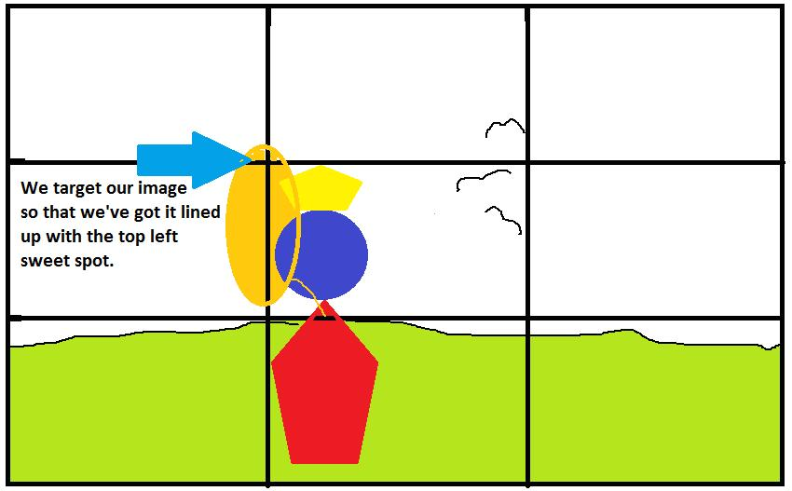
How to Apply the Rule of Thirds in Your Design

Slide 9
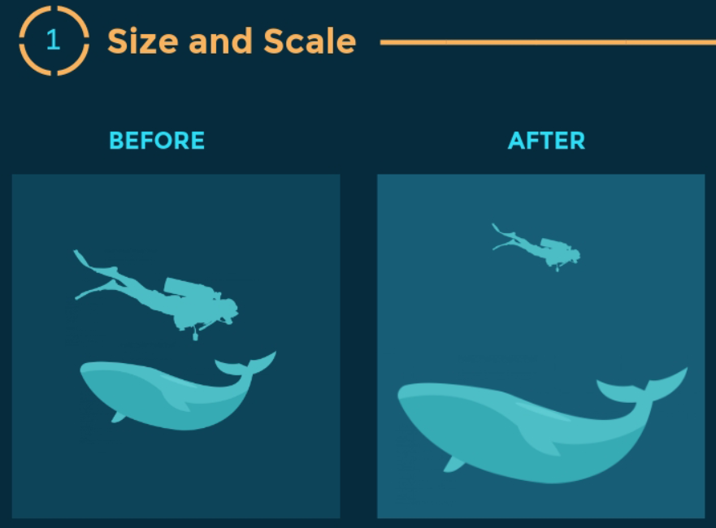
Applying the rule in design
These next slides come from the following resource: https://visme.co/blog/visual-hierarchy/

Slide 10
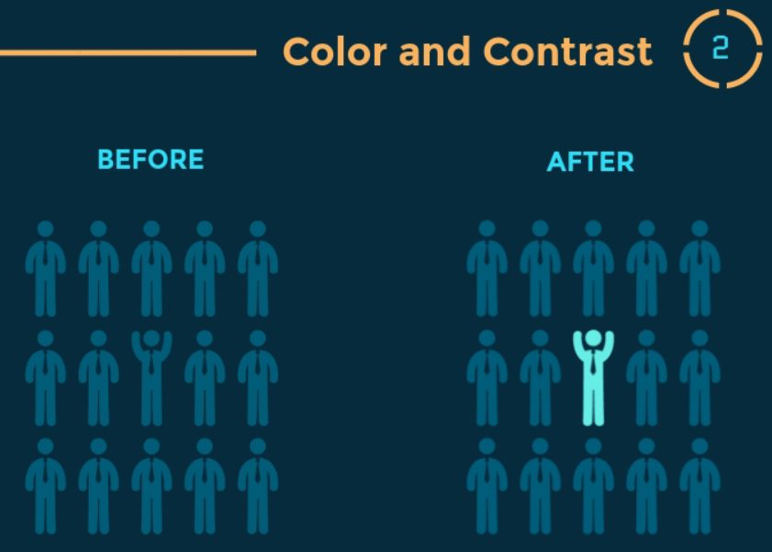
Applying the rule in design

Slide 11
Applying the rule in design

Slide 12
Applying the rule in design

Slide 13
Applying the rule in design

Slide 14
Applying the rule in design

Slide 15
References
pinterest.ca/pin/411516484677791170/?lp=true
https://www.photographymad.com/pages/view/rule-of-thirds
https://learnprophotography.com/rule-of-thirds/
https://www.designmantic.com/blog/rule-of-thirds-family-insurance-logo/
https://www.interaction-design.org/literature/article/the-rule-of-thirds-know-your-layout-sweet-spots
Resources for further research
https://www.freepik.com/blog/the-rule-of-thirds-how-it-relates-to-graphic-design/
https://visme.co/blog/visual-hierarchy/
https://www.canva.com/learn/visual-design-composition/
https://www.youtube.com/watch?v=tNNlIDoeRCM
https://www.youtube.com/watch?v=DlW6xOi8gAg

